Slide 1
Curating an Exhibition
Graffiti Art 101

Slide 2
Steps for Curating an Art Show
Come up with an idea
Build your ideal list of artists
Find a space/pitch your idea
Figure out dates for show/plan separate events during the exhibition
Put out a call for artists/go on studio visits/consign from galleries
Select specific pieces for the exhibition
Promote the exhibition
Hang the exhibition
Have the opening reception

Slide 3
Graffiti NYC
Artists of the Third Rail

Slide 4
Benrimon Contemporary, 2010
Graffiti NYC: Artists of the Third Rail features photographs, works on paper, paintings, sculptures, murals and live presentations by Martha Cooper, John Naar, Richard Hambleton, Snake1, Noc167, Jamestop, Stayhigh149, PNUT, Cap1, Tracy168, Futura2000, Dondi, Sonic BAD, INK76 and Phetus, among other legends of the third rail. This group exhibition demonstrated the trajectory of the history of graffiti in New York City. Graffiti NYC: Artists of the Third Rail was curated by Molly Sampson in collaboration with Mario Ramos (ARE) and Claudia Bumbac (DIA).

Slide 5
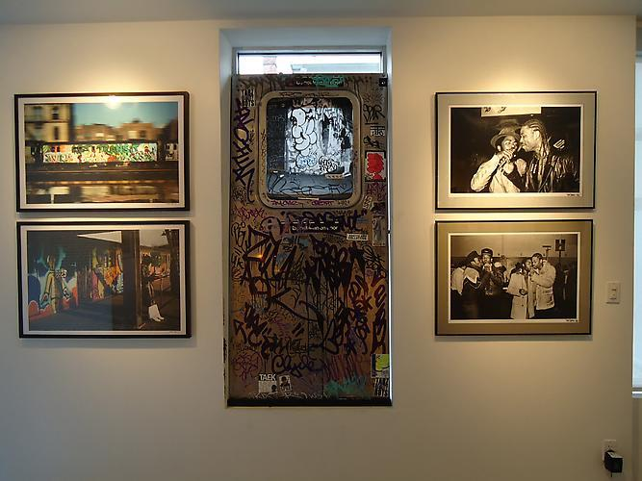

Slide 6
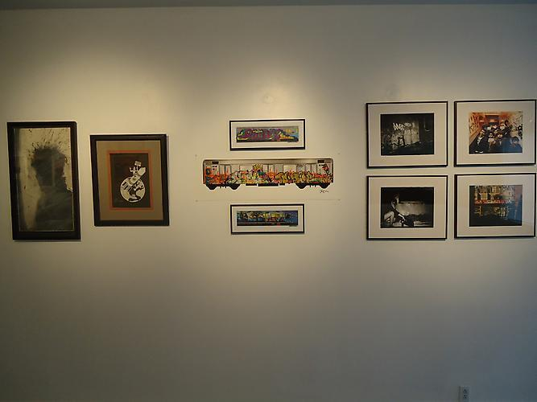

Slide 7
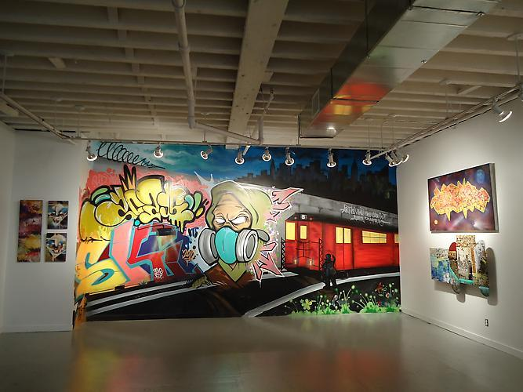

Slide 8
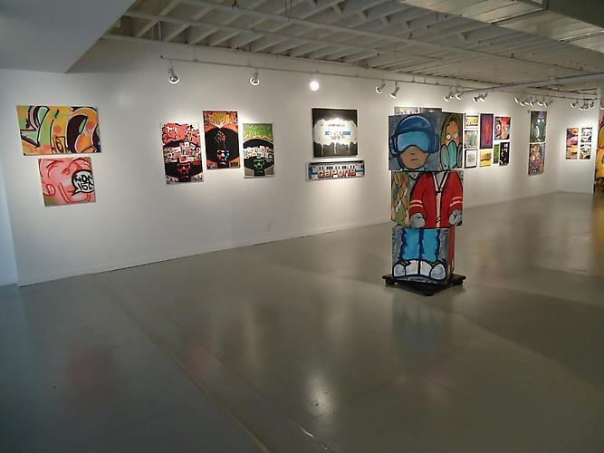

Slide 9
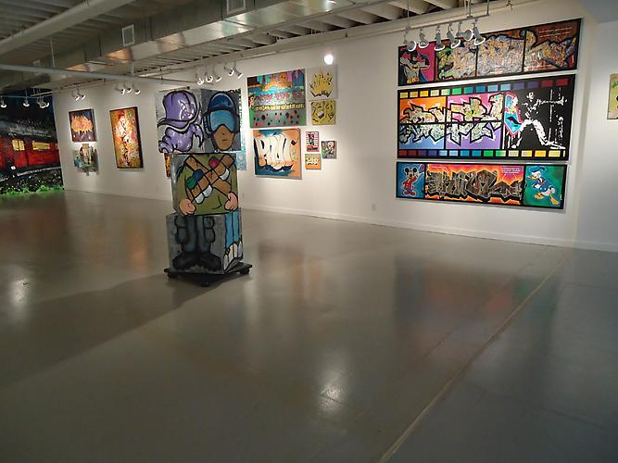

Slide 10
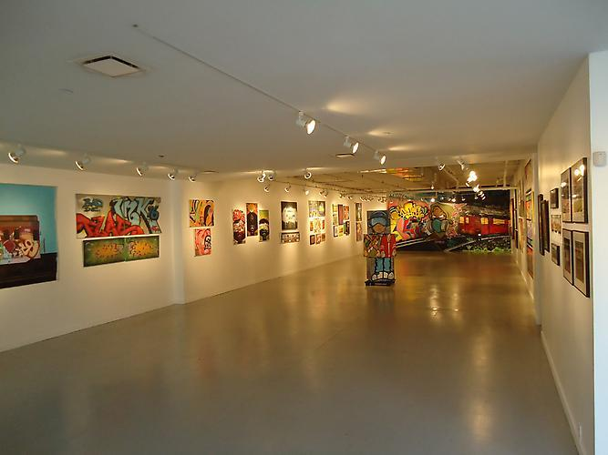

Slide 11
Love Me

Slide 12
Benrimon Contemporary, 2012
Love Me was a group exhibition featuring site specific installations, sculptures, and works on canvas created by Adam Bateman, Piper Brett, Michelle Carollo, Travis Childers, Alastair Levy and Hyungsub Shin. Their works demonstrated the varied effects manipulating the banal can achieve. Curated by Molly Sampson and Andrea Serbonich.

Slide 13
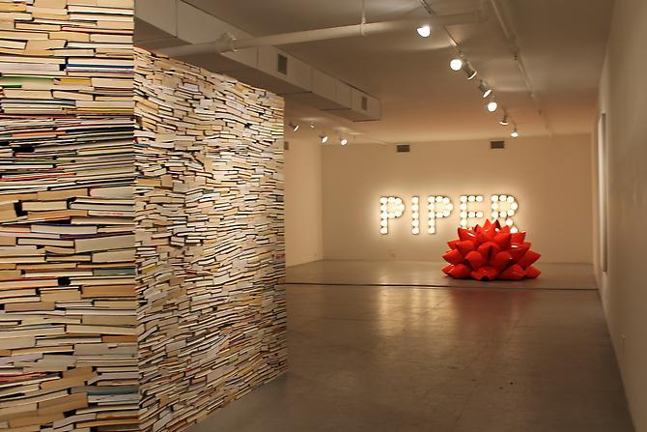

Slide 14
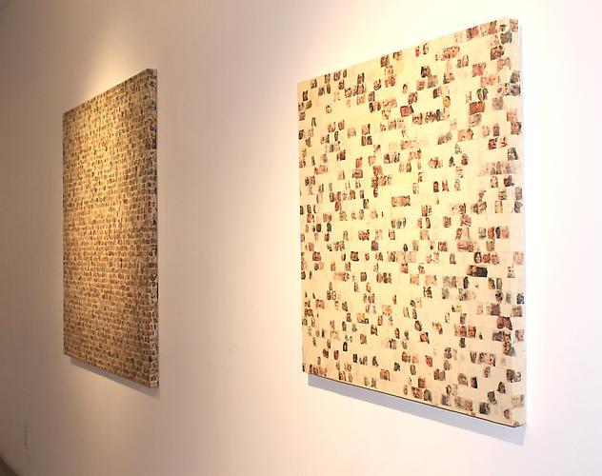

Slide 15
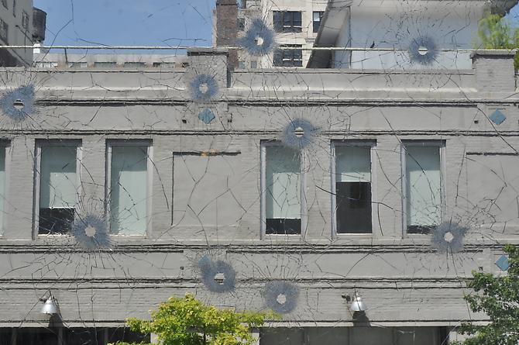

Slide 16
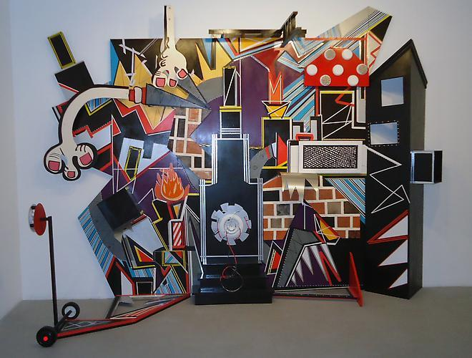

Slide 17
Off the Walls
SPARKBOOM

Slide 18
The Huntington Arts Council, 2013
Off the Walls was a mural project during August 2013. MASPAZ, PHETUS, SONIC BAD and INK76 painted three different walls as a part of SPARKBOOM for The Huntington Arts Council. The walls were completed live during a public event that included live music, a street fair and food trucks.

Slide 19
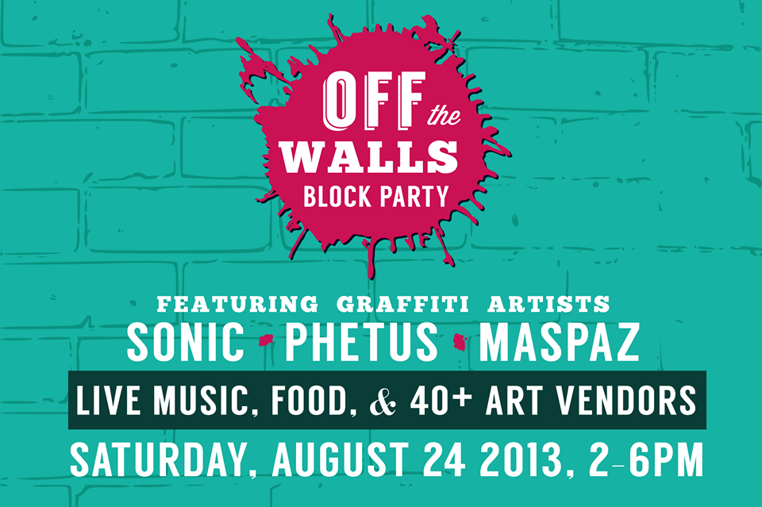

Slide 20
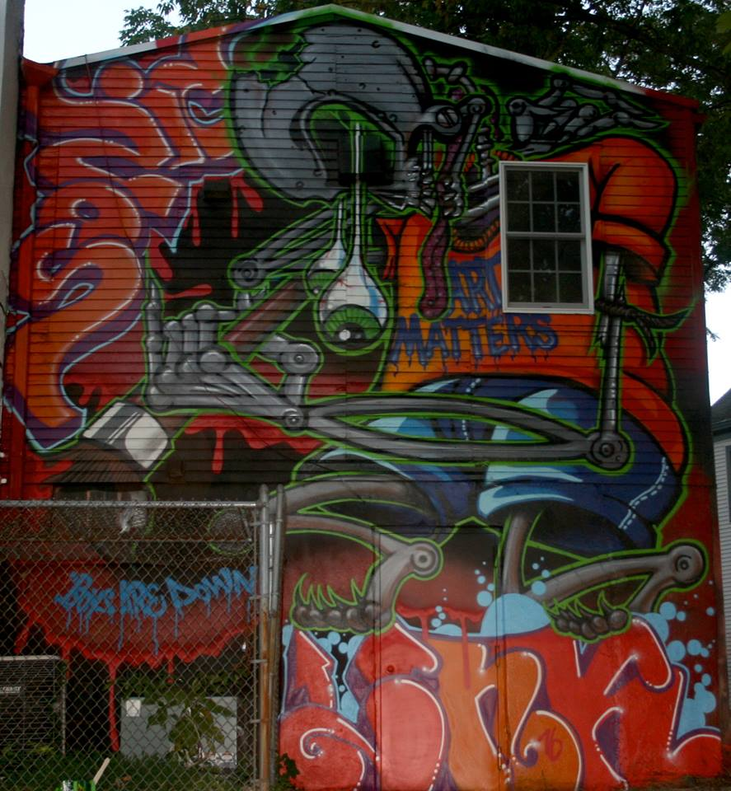

Slide 21
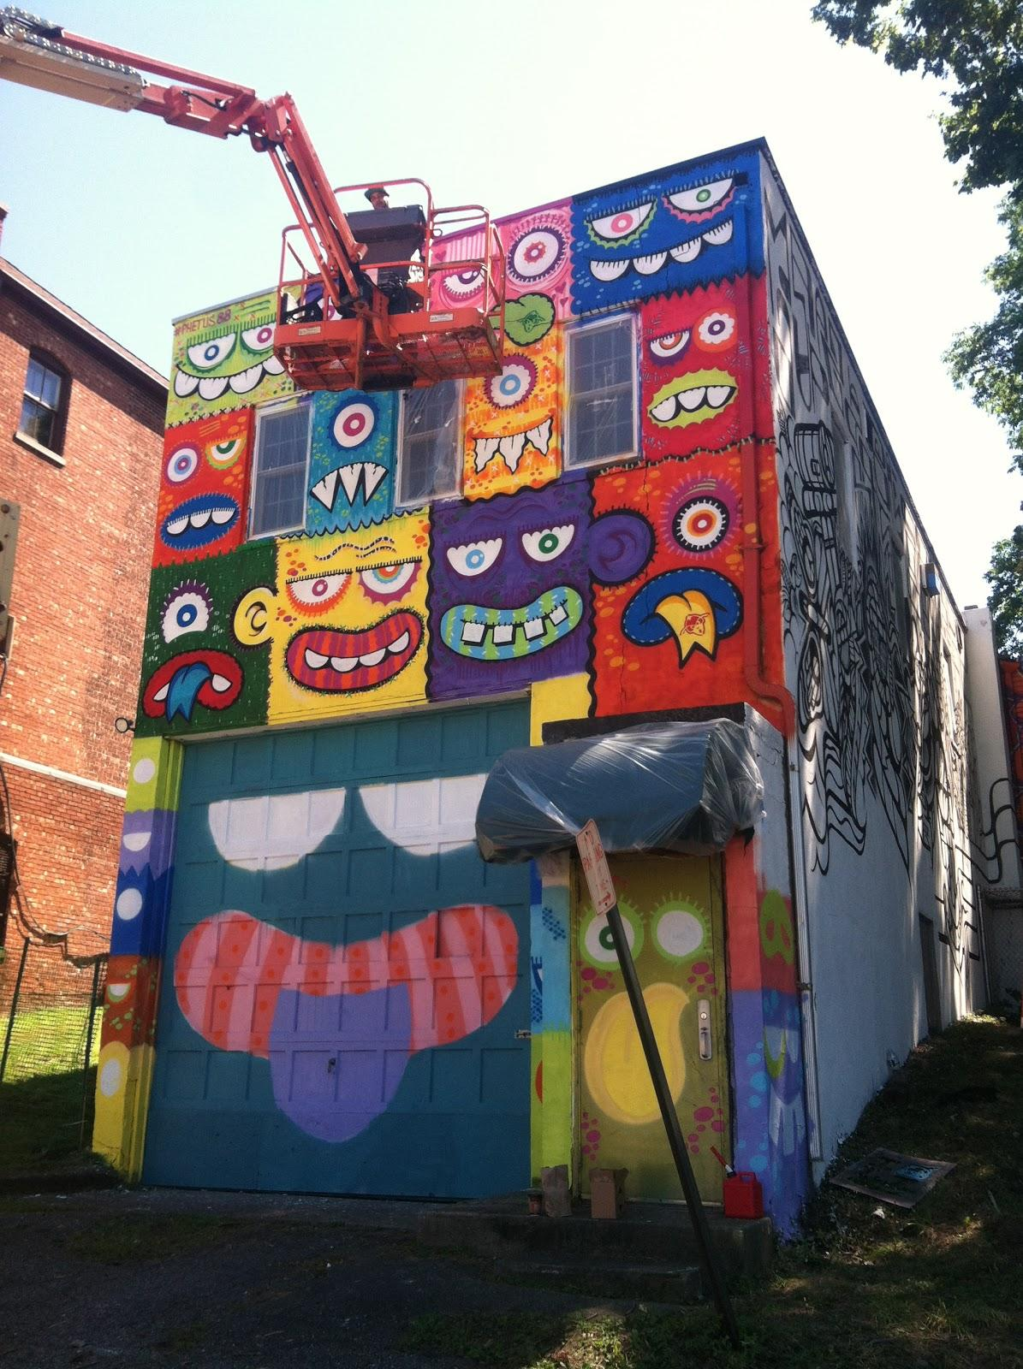

Slide 22
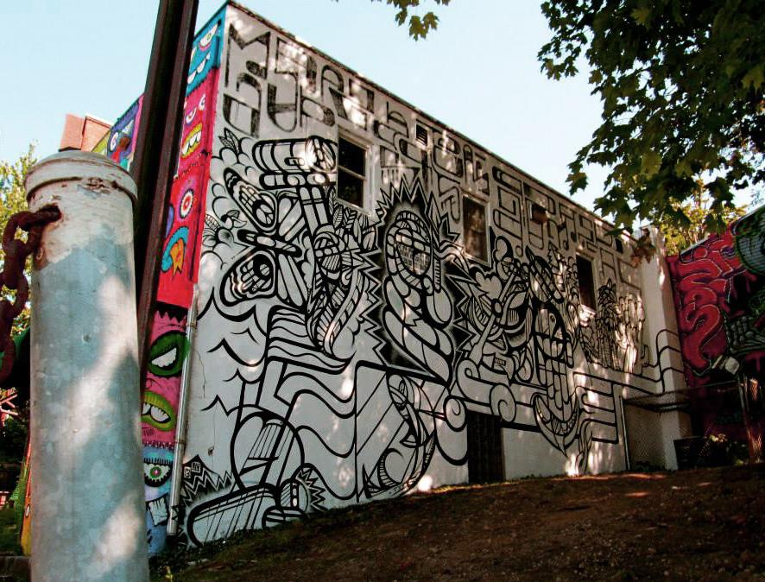

Slide 23
Post No Bills
SPARKBOOM

Slide 24
The Huntington Arts Council, 2013
Post No Bills was a public art project that replaced advertisements in bus shelters with poster replications of art work. This opportunity was organized by The Huntington Arts Council for SPARKBOOM. The posters were put into the shelters in September 2013 and were up for 3 months. Twelve artists were selected: Renne Adolina, Anu Annam, Ai Campbell, Jen P. Harris, Justin Irvin, Drew Kane, Daniel Kudreyko, Cynthia Lau, Albert Lee, Susan Reedy, Jenevieve Reid, and Adrience Reynolds.

Slide 25
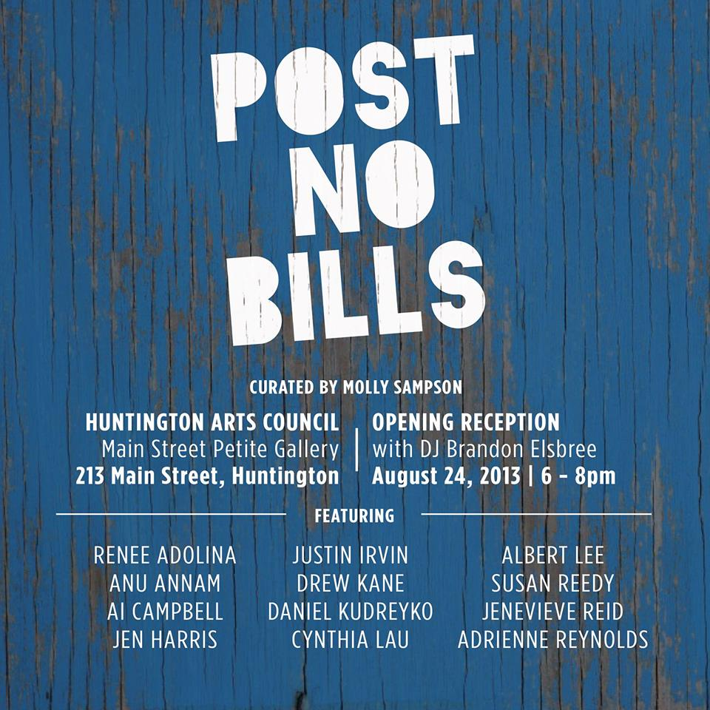

Slide 26
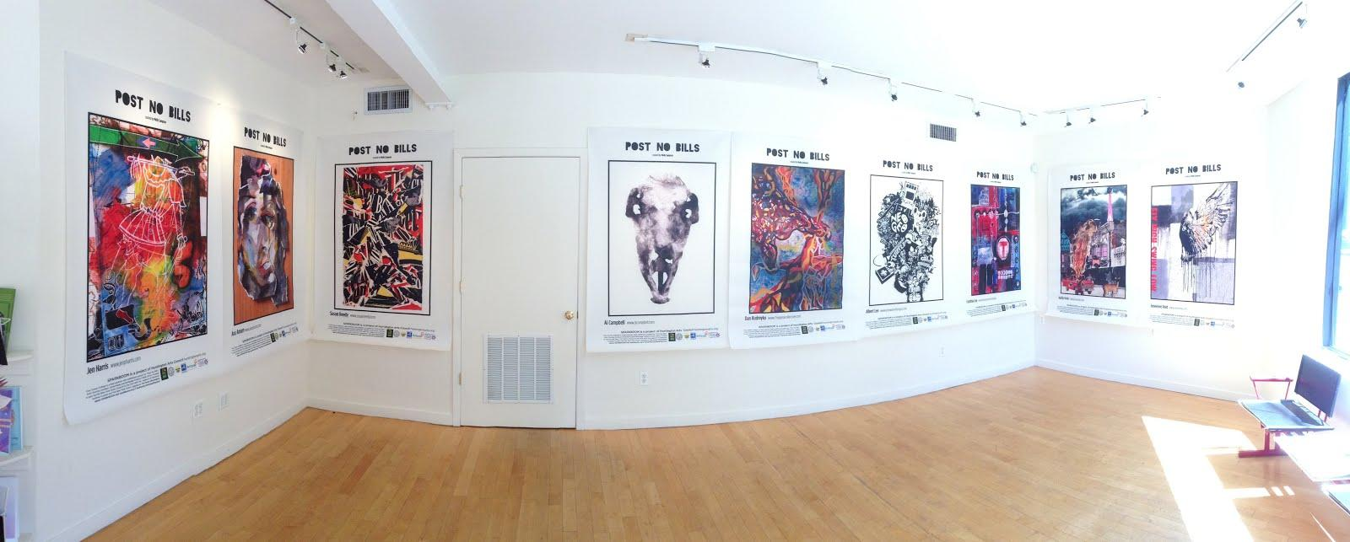

Slide 27
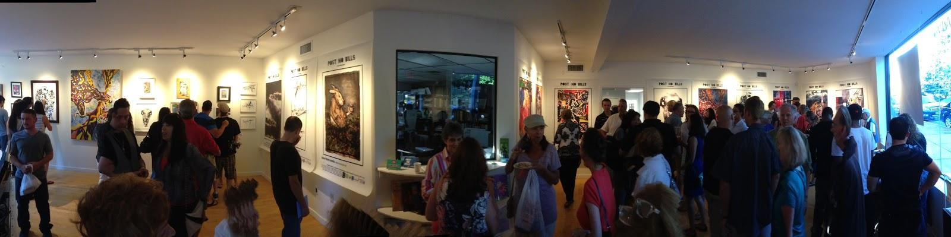

Slide 28
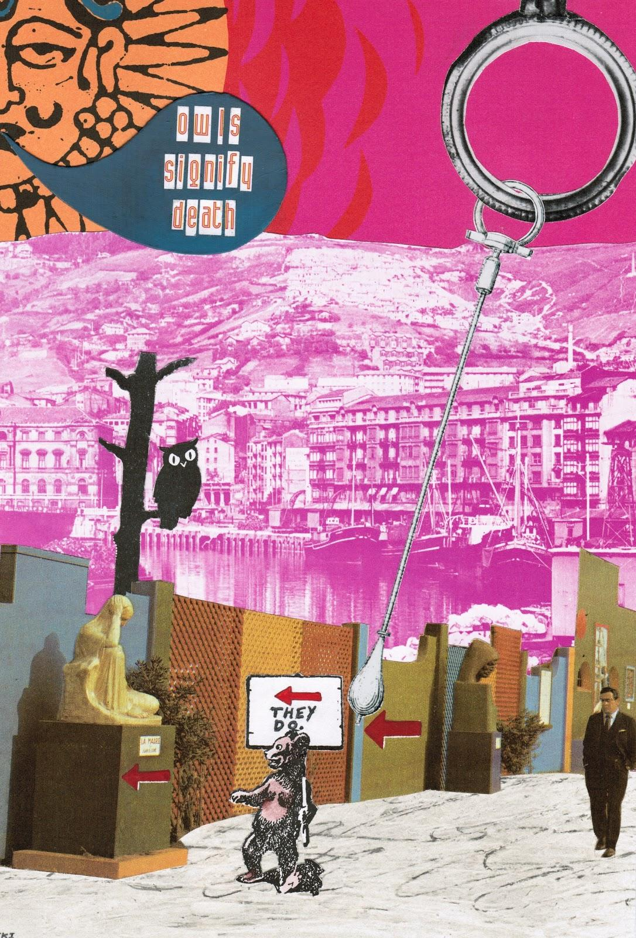

Slide 29
The Sheboygan Project

Slide 30
JMKAC and Wooster Collective
The Sheboygan Project aims to connect artists with available wall space and resources to create unique site specific works in Sheboygan, Wisconsin. Wooster Collective founders Marc and Sara Schiller have celebrated ephemeral art placed on streets in cities throughout the world since 2001. As part of a yearlong project that began in 2012, Wooster Collective, the John Michael Kohler Arts Center, renowned street artists, area residents, civic organizations, businesses, and property owners have worked together to locate potential street-art sites throughout the city.

Slide 31
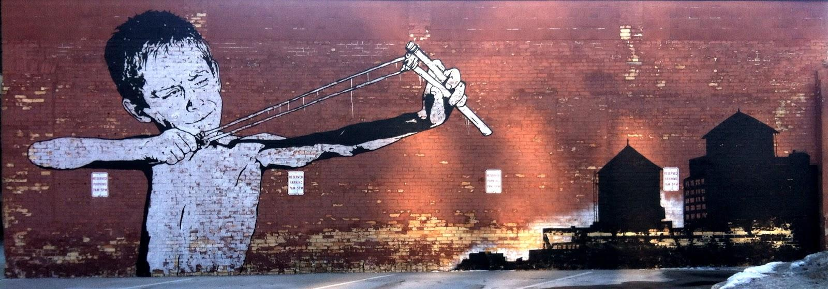

Slide 32
