Slide 1
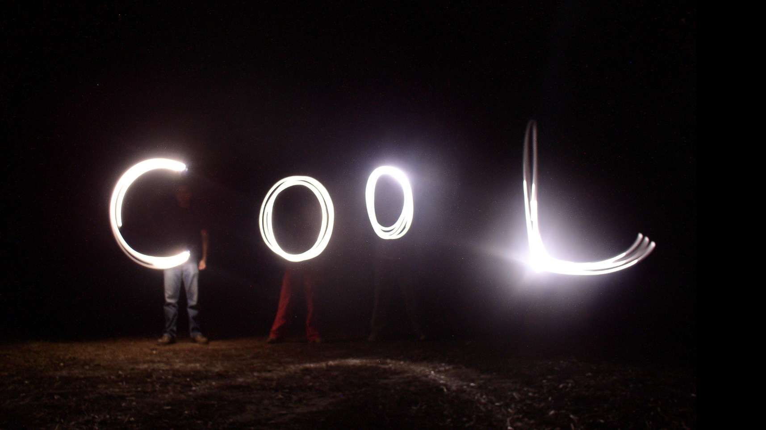
High-Tech Creativity
Presented by Jeff Leismer, PhD to Sheboygan North High School
Friday, January 9, 2026
Notes:
Presentation to high school students to teach them about use of creativity in a hightech start-up and to share my personal experience in applying creativity in the workplace

Slide 2

NASA Astronaut, Col. Jeff Williams, PhD

Slide 3
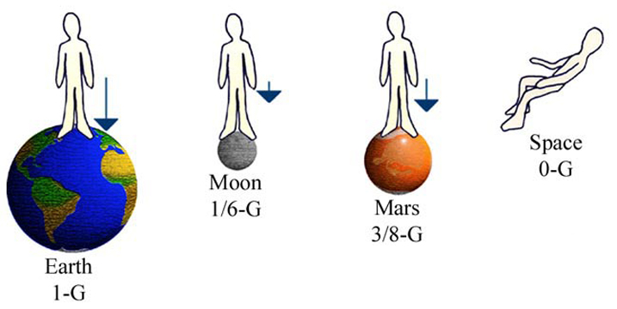
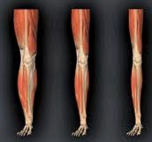
Quiz Time
Older Adults
People living with disabilities and various disabling conditions
People recovering from injury and surgery
People who are sedentary

Slide 4
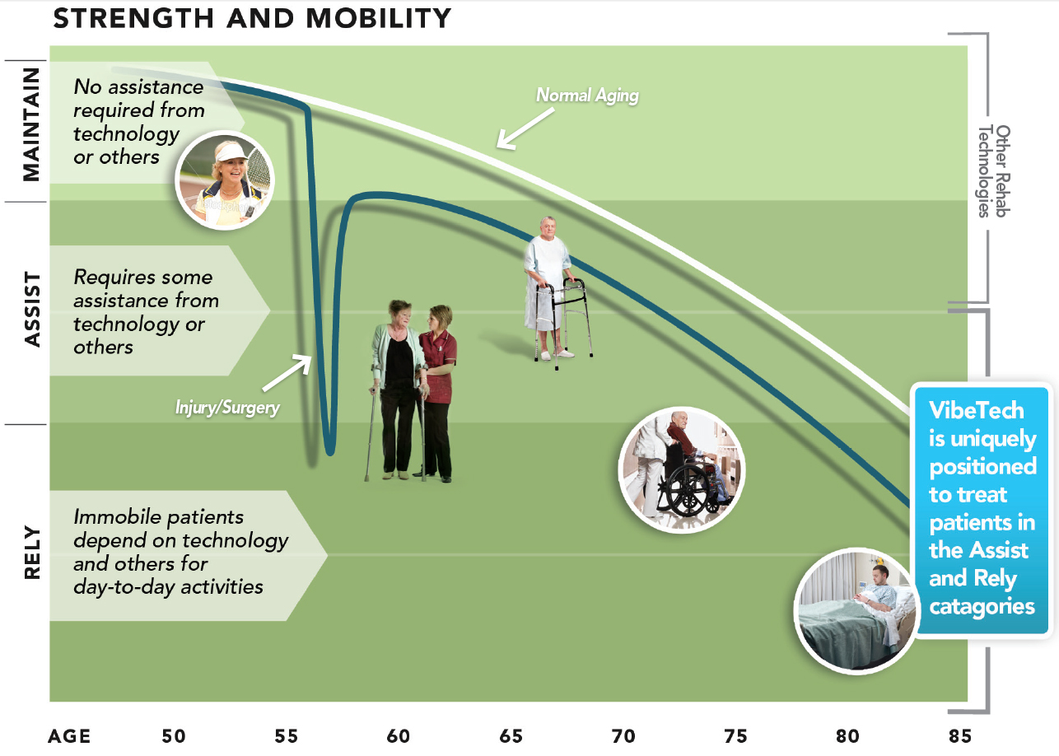
Quiz Question 2
Are there people on Earth who also experience disuse atrophy? Who?

Slide 5
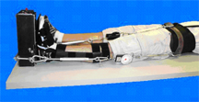
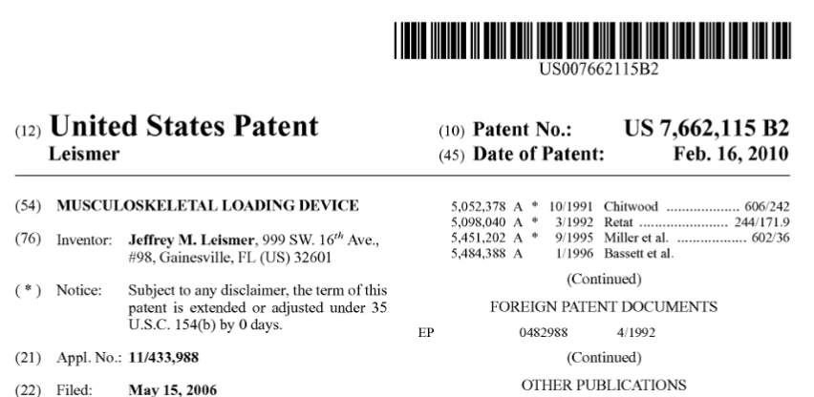
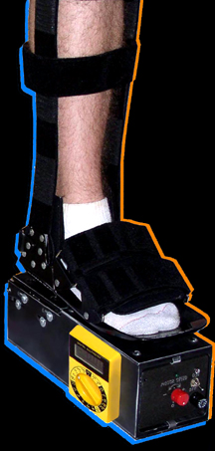
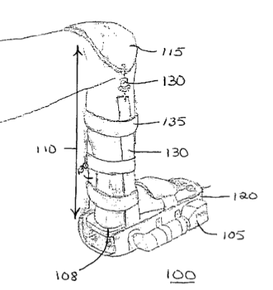
Gravity Independent Vibration Therapy System

Slide 6
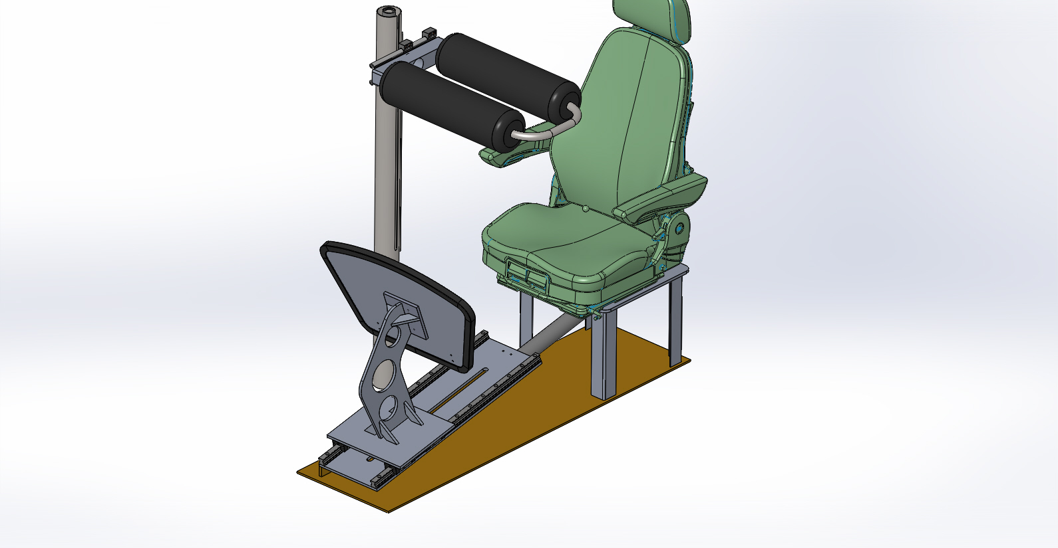

Slide 7
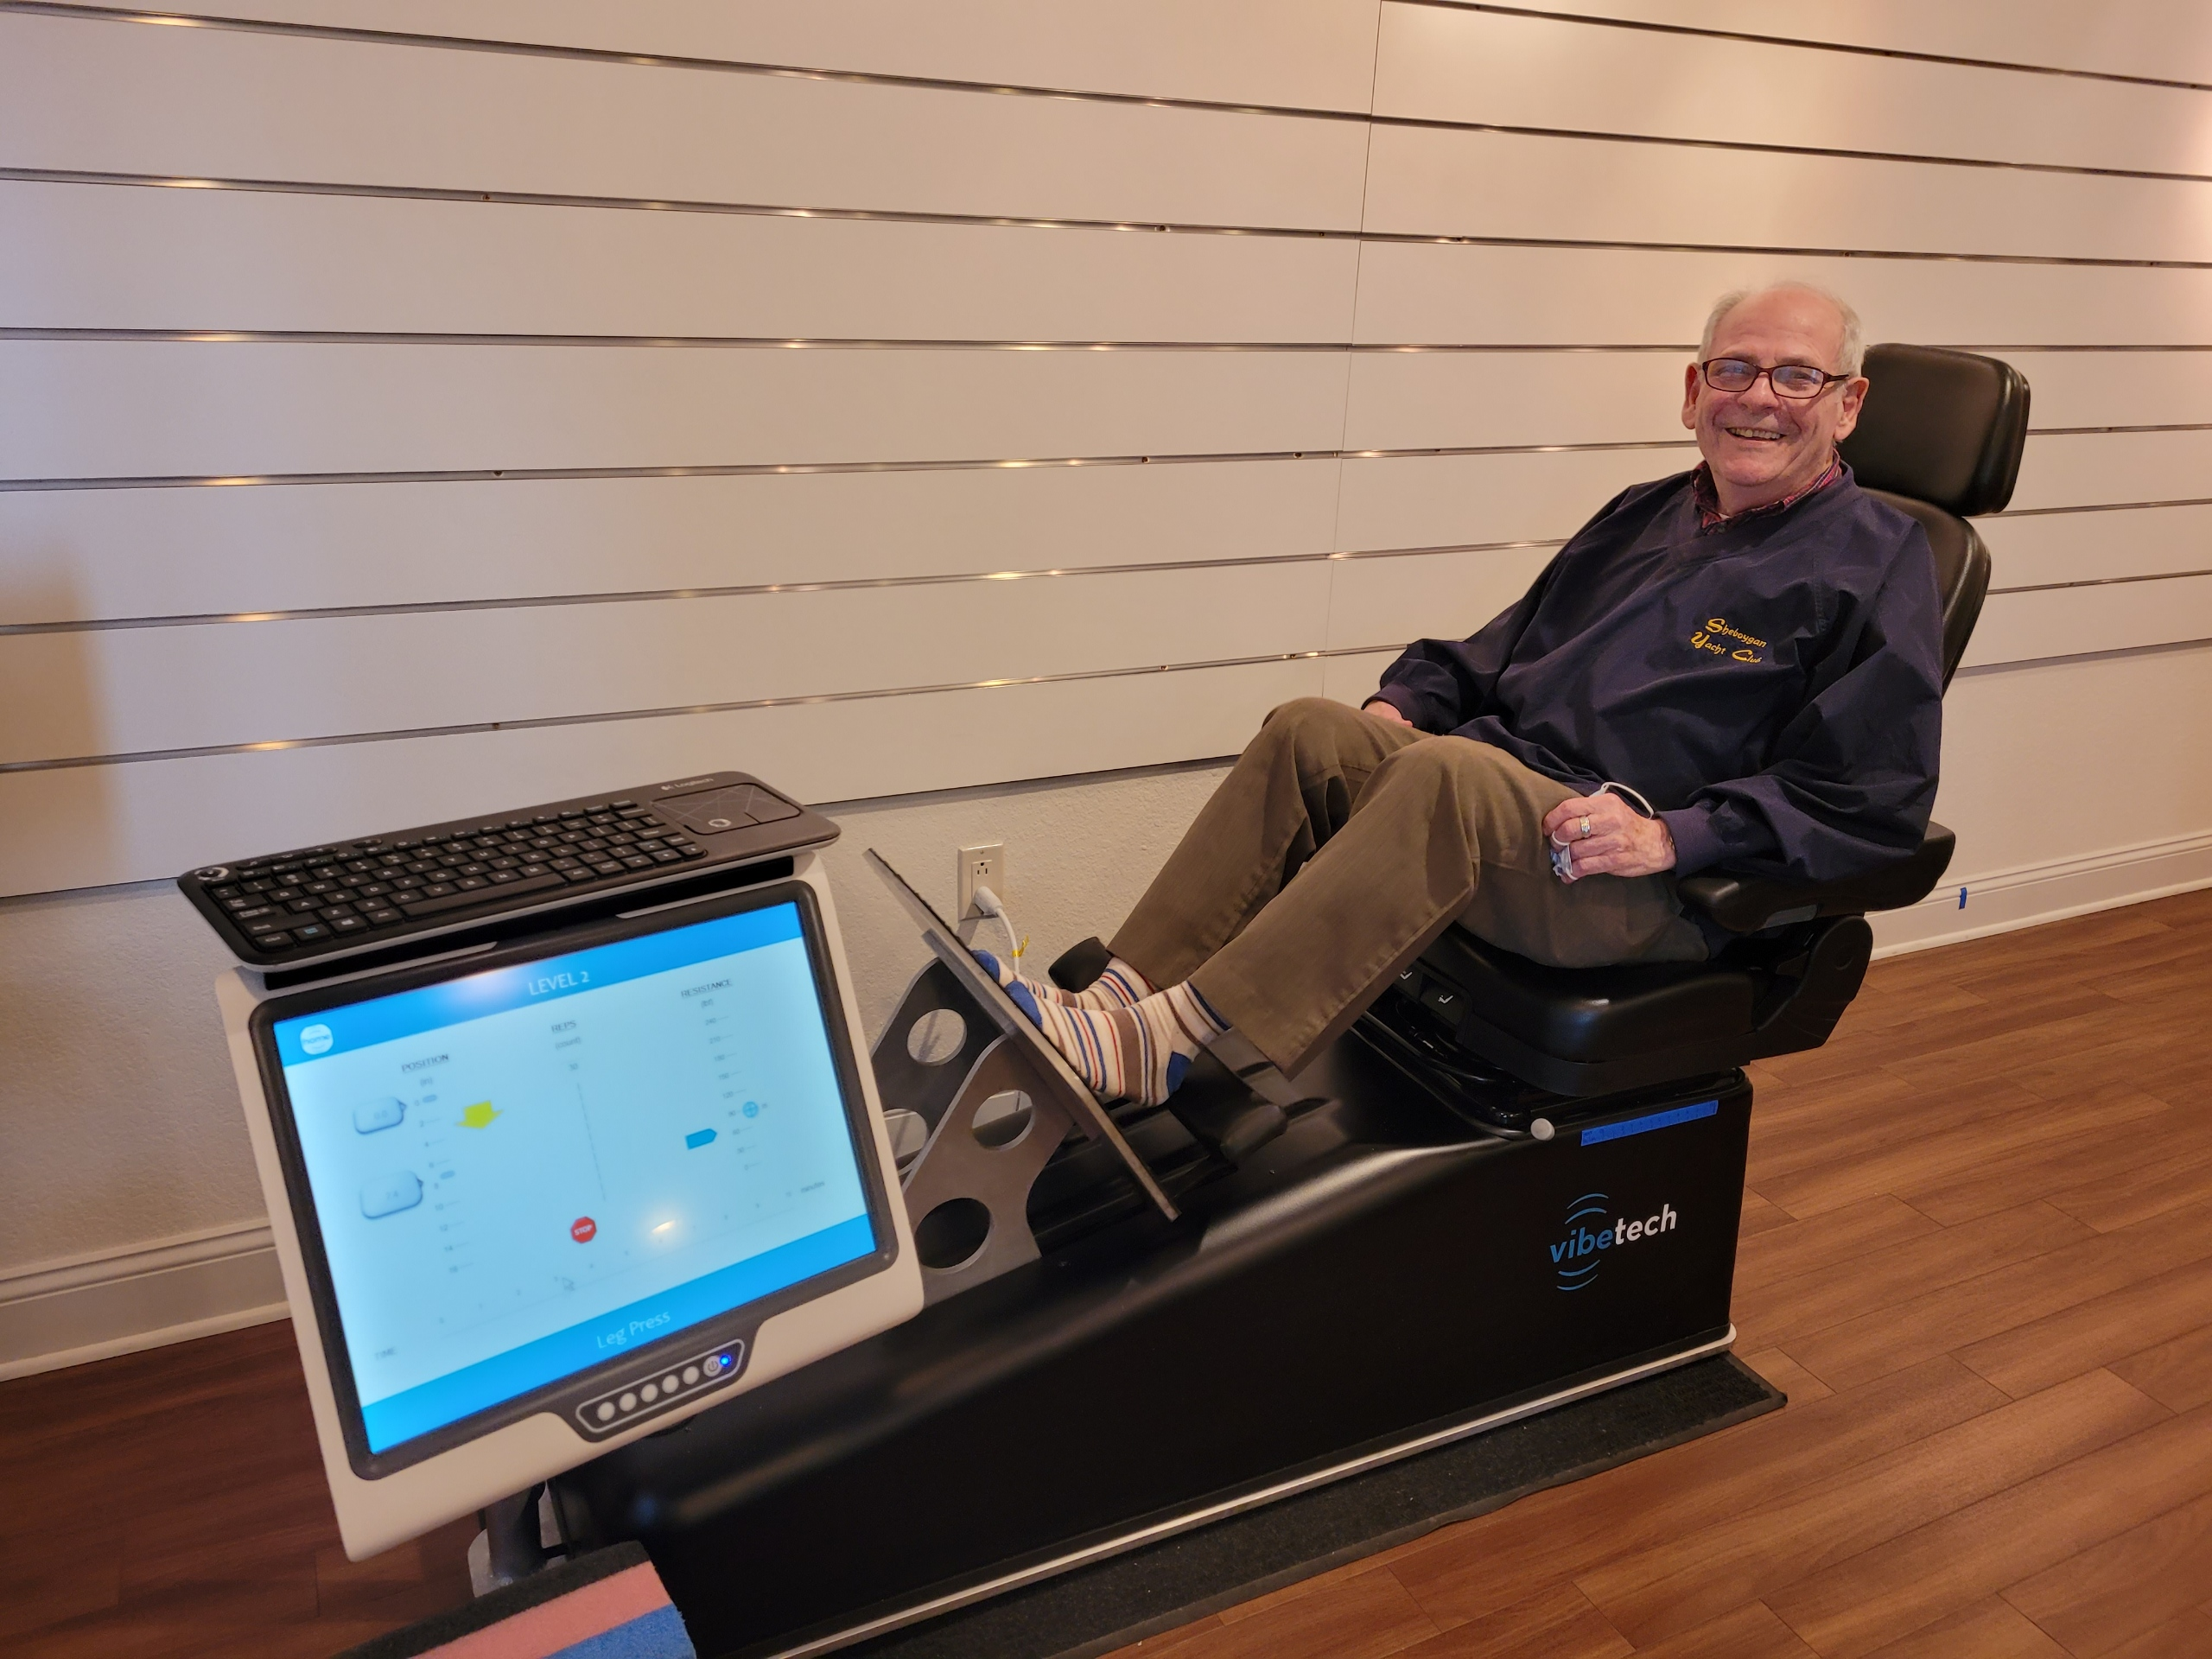
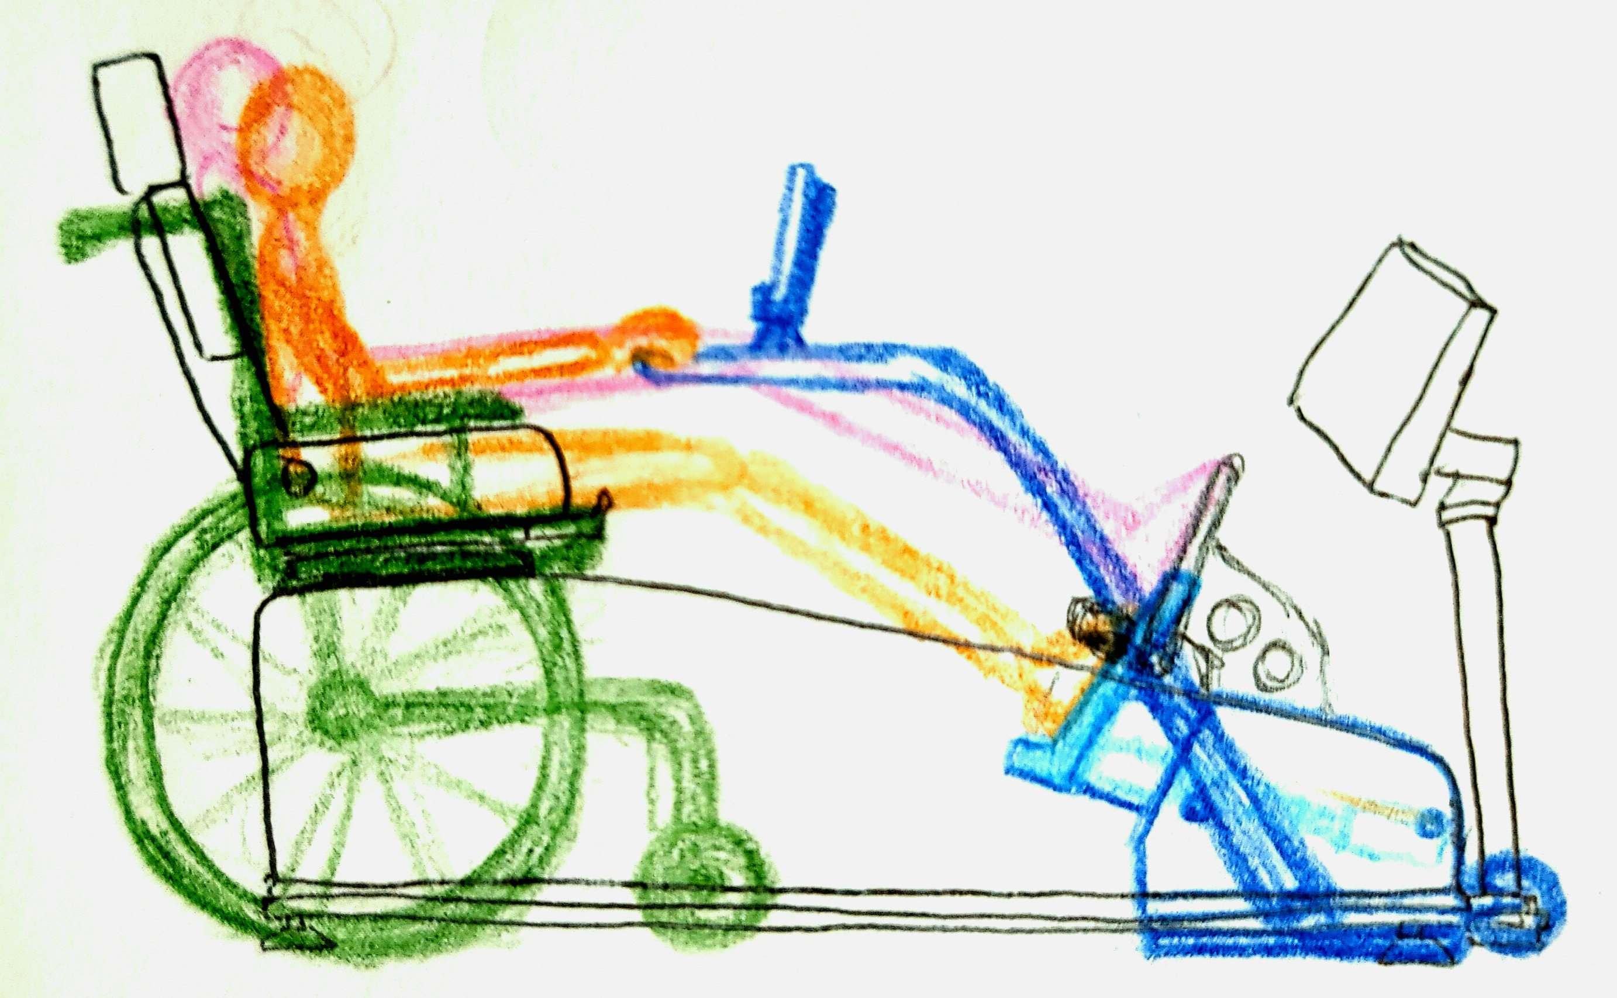
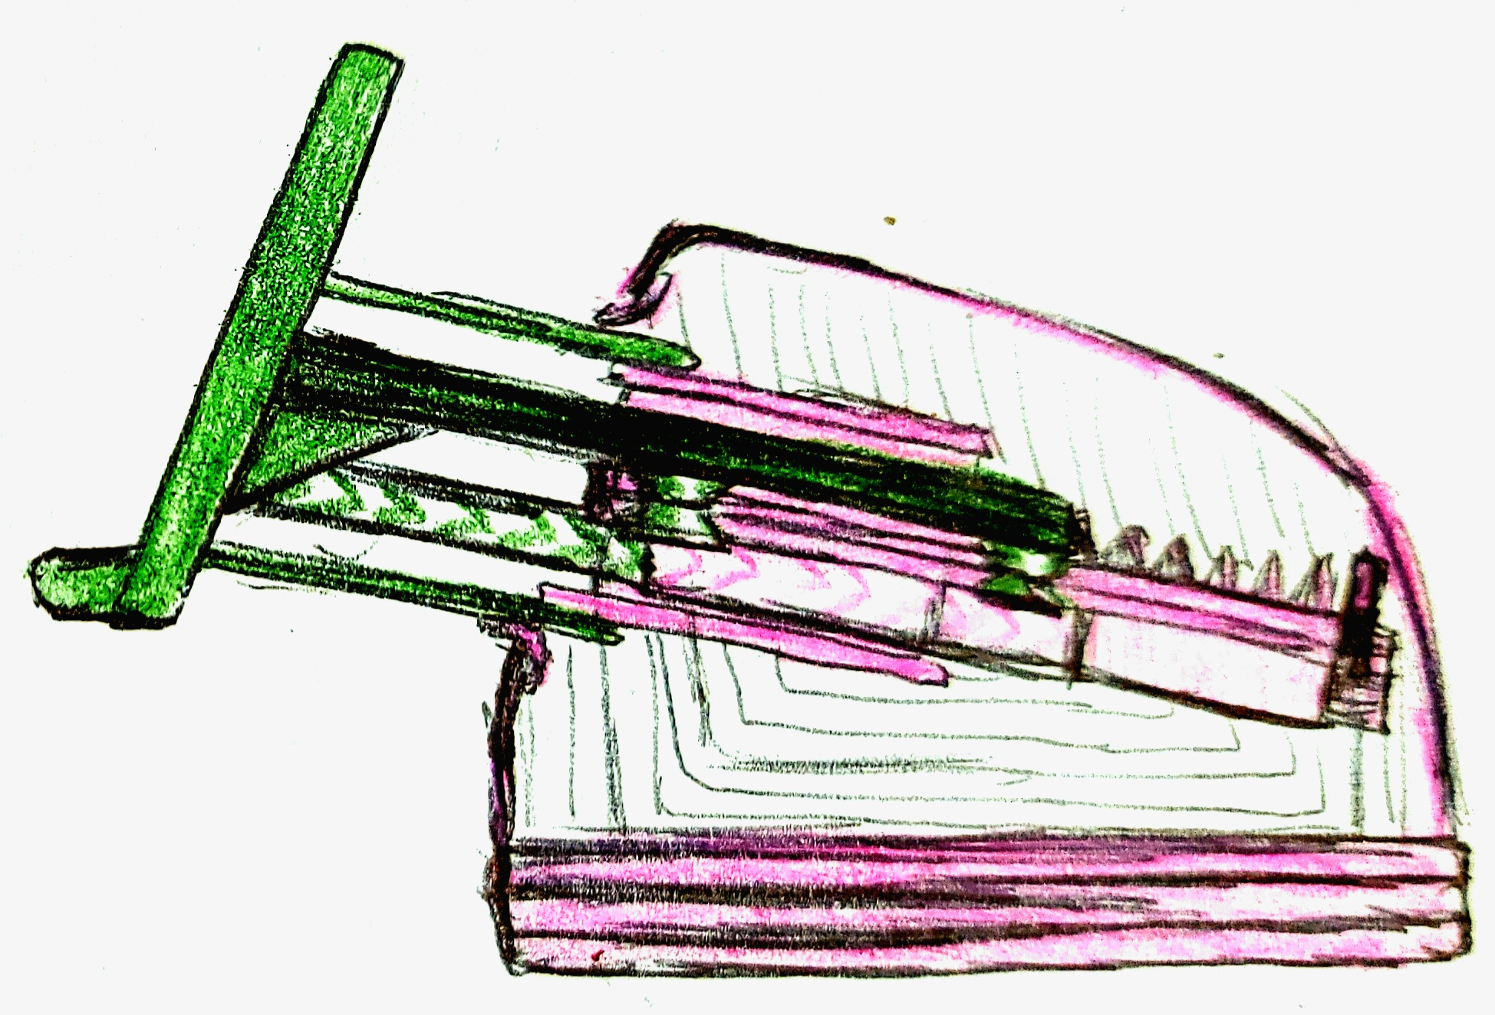

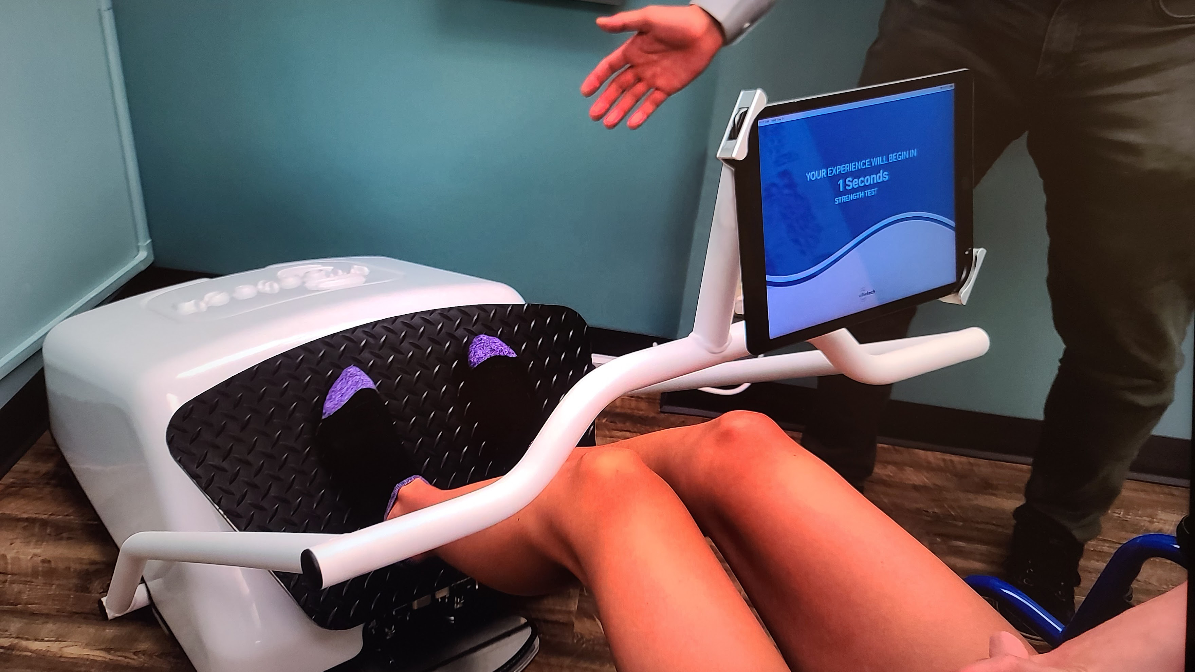
Adapting Designs to be More Accommodating

Slide 8
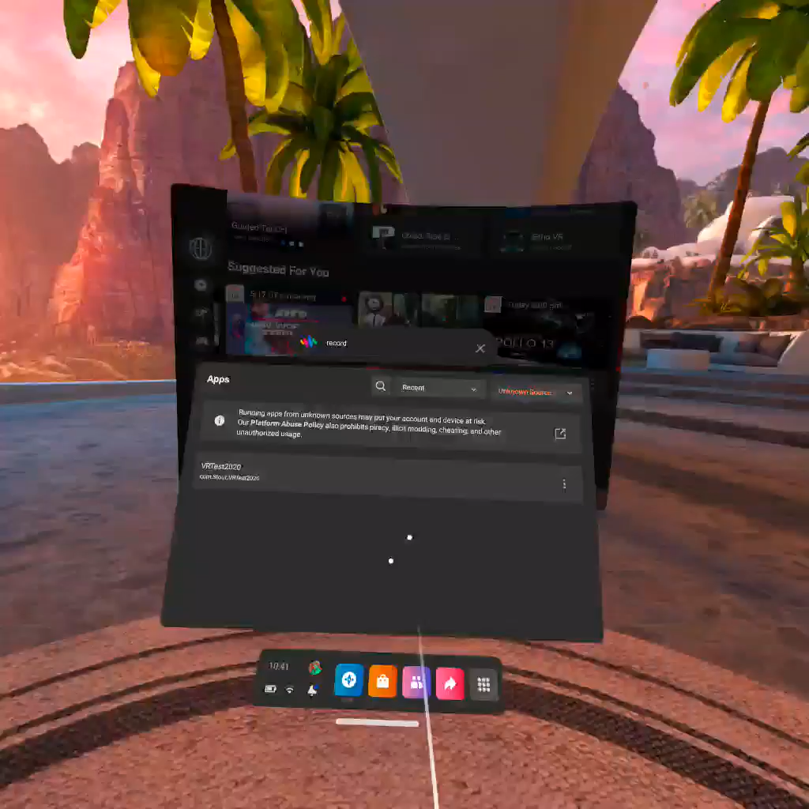
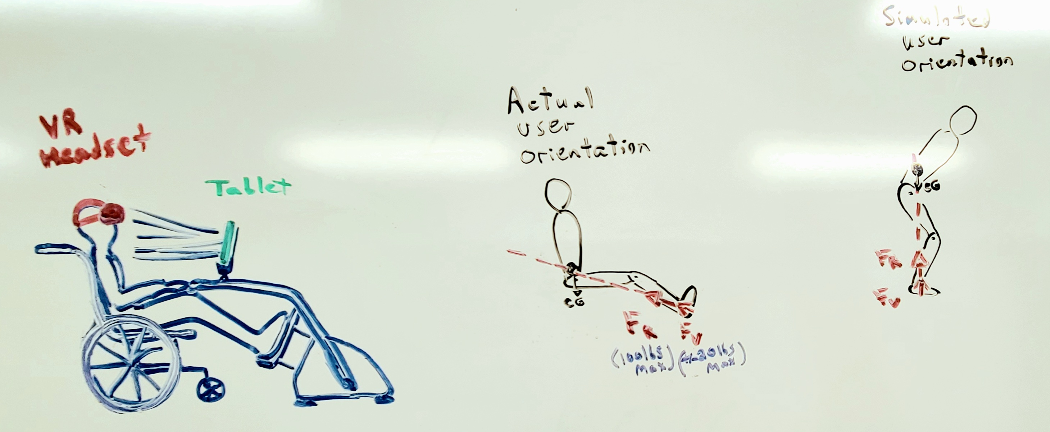
Digital Creativity

Slide 9
Practice Using Creative Skills
Weekly Drawings
Observe, understand, interpretive depiction
Design Projects
Kickoff is key to inserting creativity
Document and Protect
The patent process

Slide 10

Inspiring Creativity
Quiet your mind
Observe with all your senses
Critique the objects of your observations
Do more
Notes:
1. Spend more time in silence and meditation, because a centered mind can generate new ideas with less effort than one that is distracted or off on a tangent.
2. Practice the art of observation. Take notes, draw what you observe, built or sculpt models, starting with simplified ones, then add details and complexities. Keep non-objective about what you observe until there is sufficient detail and knowledge to judge it.
3. Critique the objects of your observations. Be sure to generate both positive and negative feedback about your observations. This will let you objectively pursue creative approaches to solve your problem. This approach can be applied to anything in life.
4. Do More. The more you are exposed to, the more you learn and the more arsenal you have to solve problems nobody else has yet exhaustively pursued.

